Slide 1
BIEN 401 Biomedical Mass Transport Class 9 Exam 1 Review
notes prepared by
Dr. Louis Reis
Created on 3/25/2022

Slide 2
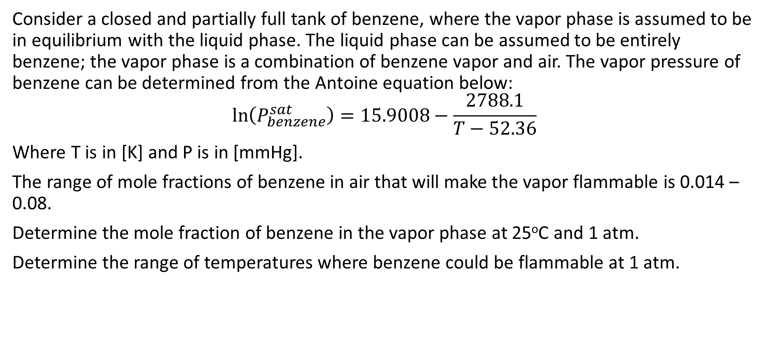
Problem 1
Consider a closed and partially full tank of benzene, where the vapor phase is assumed to be in equilibrium with the liquid phase. The liquid phase can be assumed to be entirely benzene; the vapor phase is a combination of benzene vapor and air. The vapor pressure of benzene can be determined from the Antoine equation below:
$$\ln\left(P_{benzene}^{sat}\right)=15.9008−\frac{2788.1}{T−52.36}$$
Where T is in [K] and P is in [mmHg].
The range of mole fractions of benzene in air that will make the vapor flammable is 0.014 – 0.08.
Determine the mole fraction of benzene in the vapor phase at 25ºC and 1 atm.
Determine the range of temperatures where benzene could be flammable at 1 atm.

Slide 3
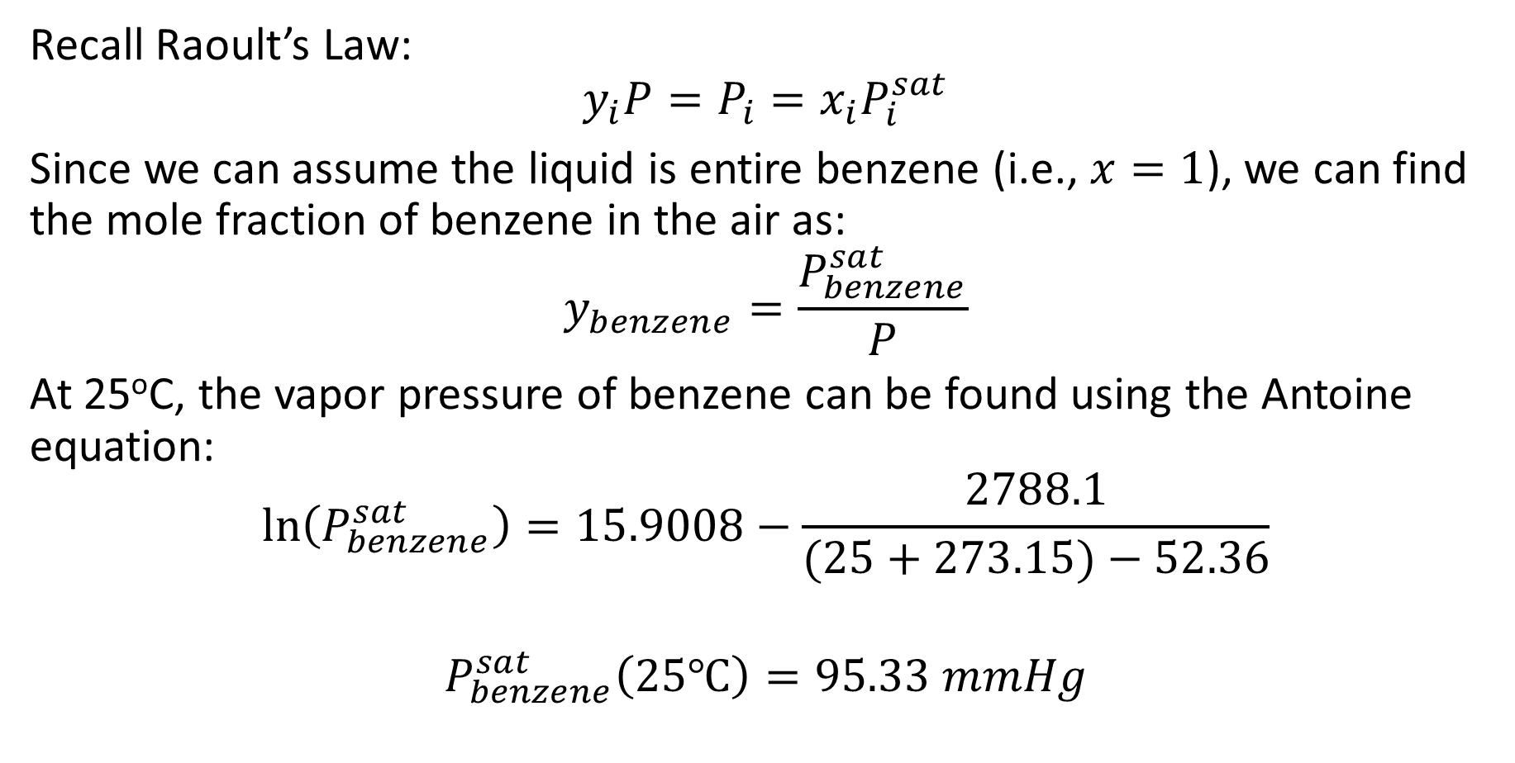
Problem 1 Solution
Recall Raoult’s Law:
$$y_{i}P=P_{i}=x_{i}P_{i}^{sat}$$
Since we can assume the liquid is entire benzene (i.e., $x=1$), we can find the mole fraction of benzene in the air as:
$$y_{benzene}=\frac{P_{benzene}^{sat}}{P}$$
At 25ºC, the vapor pressure of benzene can be found using the Antoine equation:
$$\ln\left(P_{benzene}^{sat}\right)=15.9008−\frac{2788.1}{(25+273.15)−52.36}$$
$$P_{benzene}^{sat}\left(25℃\right)=95.33 mmHg$$

Slide 4
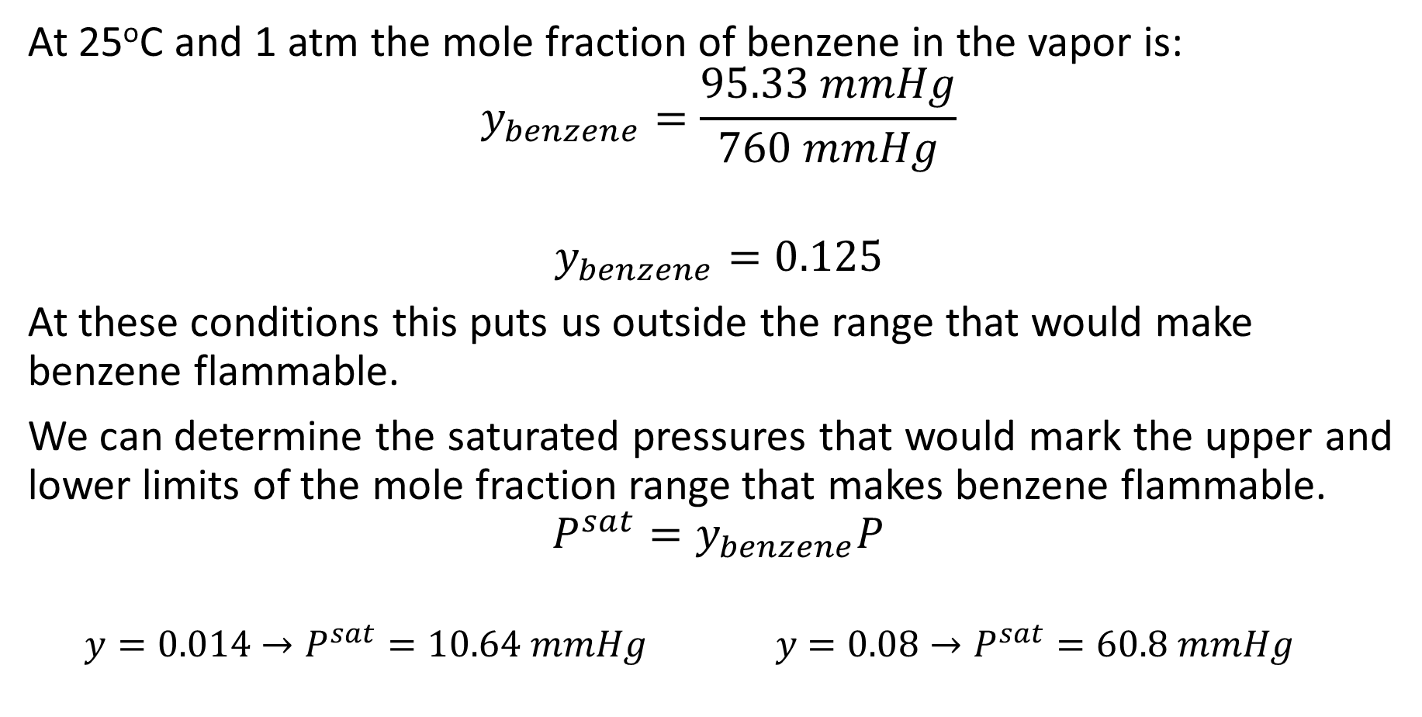
Problem 1 Solution
At 25ºC and 1 atm the mole fraction of benzene in the vapor is:
$$y_{benzene}=\frac{95.33 mmHg}{760 mmHg}$$
$$y_{benzene}=0.125$$
At these conditions this puts us outside the range that would make benzene flammable.
We can determine the saturated pressures that would mark the upper and lower limits of the mole fraction range that makes benzene flammable.
$$P^{sat}=y_{benzene}P$$
$$y=0.014→P^{sat}=10.64 mmHg y=0.08→P^{sat}=60.8 mmHg$$

Slide 5
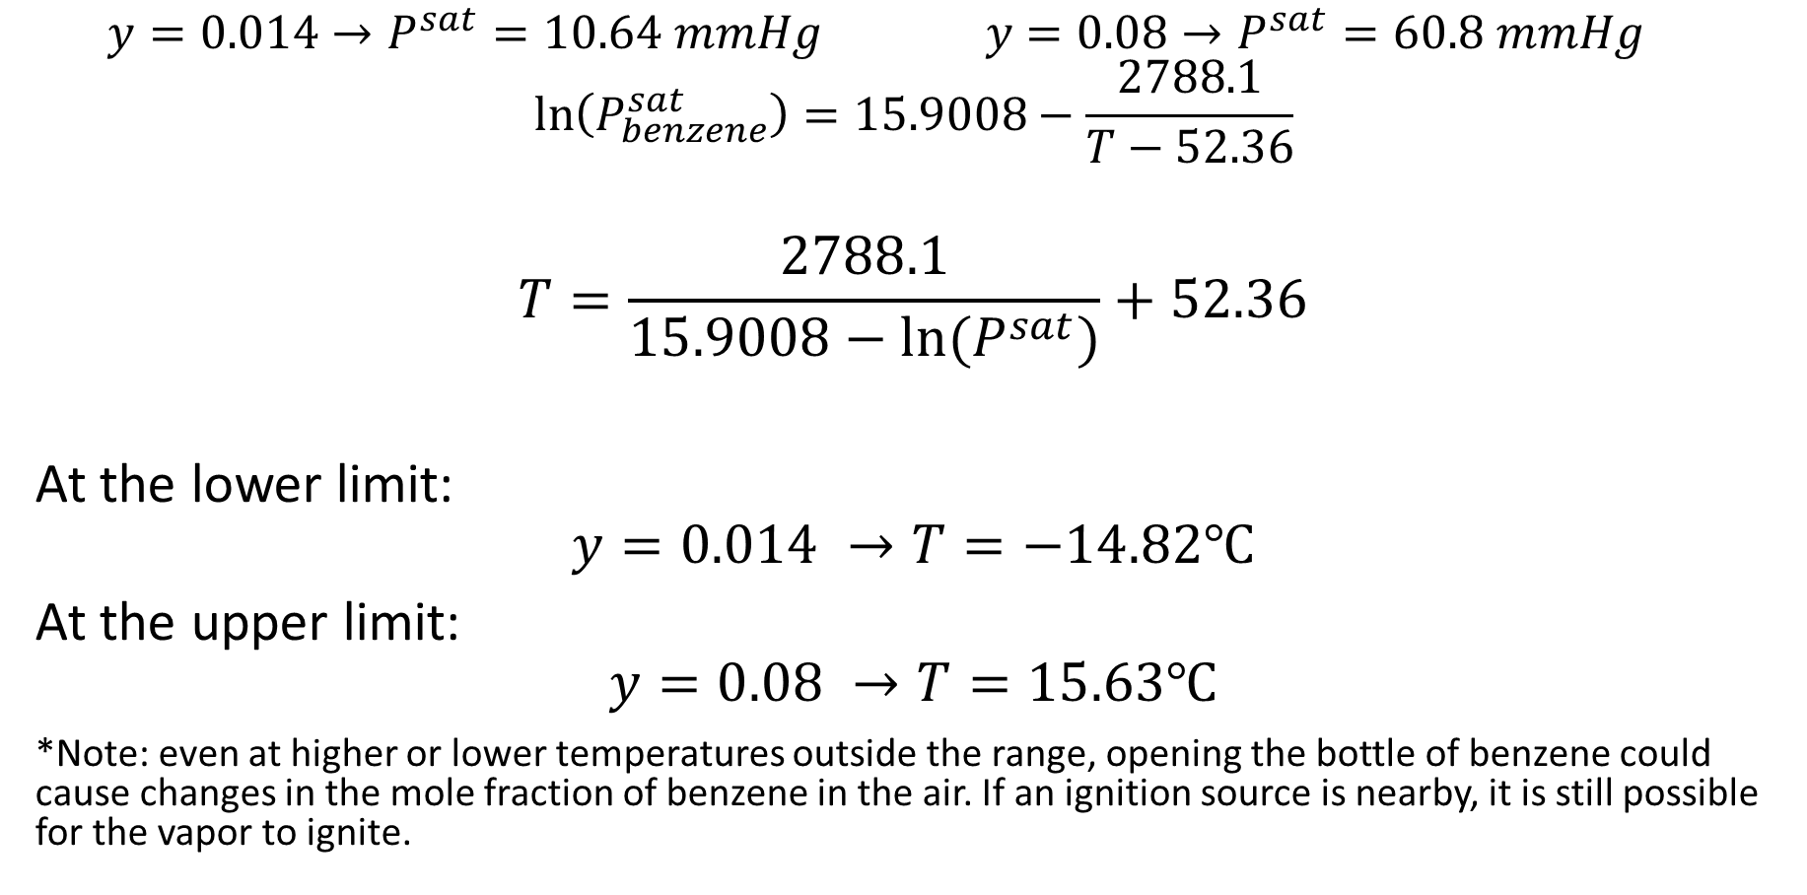
Problem 1 Solution
$$y=0.014→P^{sat}=10.64 mmHg y=0.08→P^{sat}=60.8 mmHg$$
$$\ln\left(P_{benzene}^{sat}\right)=15.9008−\frac{2788.1}{T−52.36}$$
$$T=\frac{2788.1}{15.9008−ln⁡(P^{sat})}+52.36$$
At the lower limit:
$$y=0.014 →T=−14.82℃$$
At the upper limit:
$$y=0.08 →T=15.63℃$$
*Note: even at higher or lower temperatures outside the range, opening the bottle of benzene could cause changes in the mole fraction of benzene in the air. If an ignition source is nearby, it is still possible for the vapor to ignite.

Slide 6
Problem 2
Estimate the filtrate flux at 20ºC for the filtration of a protein solution across a membrane that is impermeable to the protein. The hydraulic conductance of this membrane is 0.01 mL cm⁻² psi⁻¹ min⁻¹. The hydrodynamic pressure drop applied across the membrane is equal to 15 psi, and the protein concentration in the solution being filtered is equal to 22 g per 100 mL. The molecular weight of the protein is 69,000 g/mol.

Slide 7
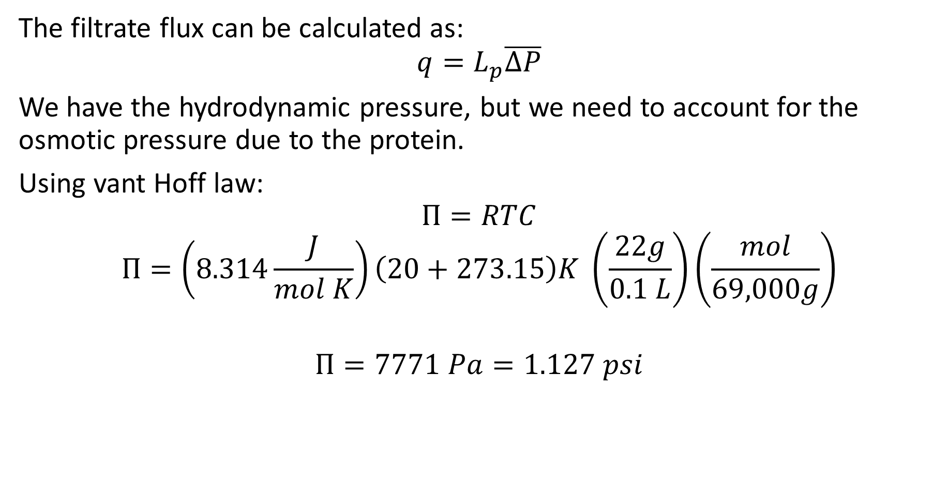
Problem 2 Solution
The filtrate flux can be calculated as:
$$q=L_{p}\overline{∆P}$$
We have the hydrodynamic pressure, but we need to account for the osmotic pressure due to the protein.
Using vant Hoff law:
$$Π=RTC$$
$$Π=\left(8.314\frac{J}{mol K}\right)\left(20+273.15\right)K \left(\frac{22g}{0.1 L}\right)\left(\frac{mol}{69,000g}\right)$$
$$Π=7771 Pa=1.127 psi$$

Slide 8

Problem 2 Solution
$$q=L_{p}\overline{∆P}=L_{p}\left[\left(P_{A}−P_{B}\right)−\left(Π_{A}−Π_{B}\right)\right]$$
$$q=\left(0.01\frac{mL}{cm^{2} psi min}\right)\left[\left(15 psi\right)−\left(1.127 psi\right)\right]$$
$$q=0.139\frac{mL}{cm^{2} min}$$

Slide 9

Problem 3
The diffusivity of a molecule in a solvent at 25ºC was experimentally found to be $4×{10}^{−6} cm^{2}/s$. The viscosity of the solvent at these conditions is 0.86 cP. Estimate the molecular weight of the molecule.

Slide 10
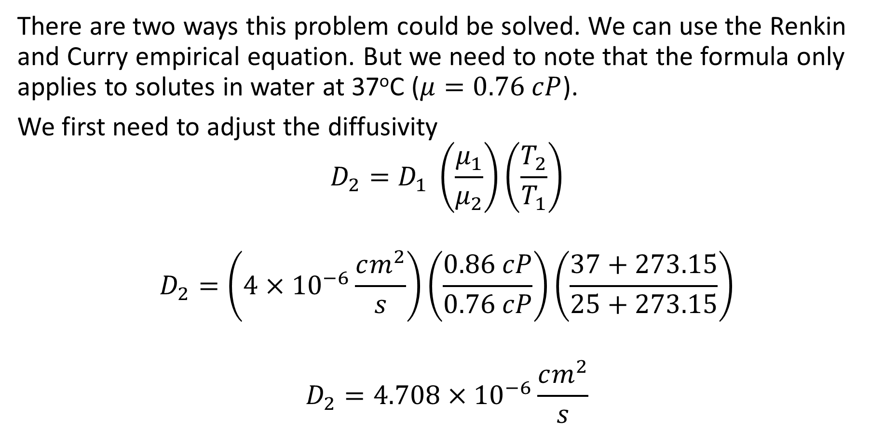
Problem 3 Solution
There are two ways this problem could be solved. We can use the Renkin and Curry empirical equation. But we need to note that the formula only applies to solutes in water at 37ºC ($μ=0.76 cP$).
We first need to adjust the diffusivity
$$D_{2}=D_{1} \left(\frac{μ_{1}}{μ_{2}}\right)\left(\frac{T_{2}}{T_{1}}\right)$$
$$D_{2}=\left(4×{10}^{−6}\frac{cm^{2}}{s}\right)\left(\frac{0.86 cP}{0.76 cP}\right)\left(\frac{37+273.15}{25+273.15}\right)$$
$$D_{2}=4.708×{10}^{−6}\frac{cm^{2}}{s}$$

Slide 11
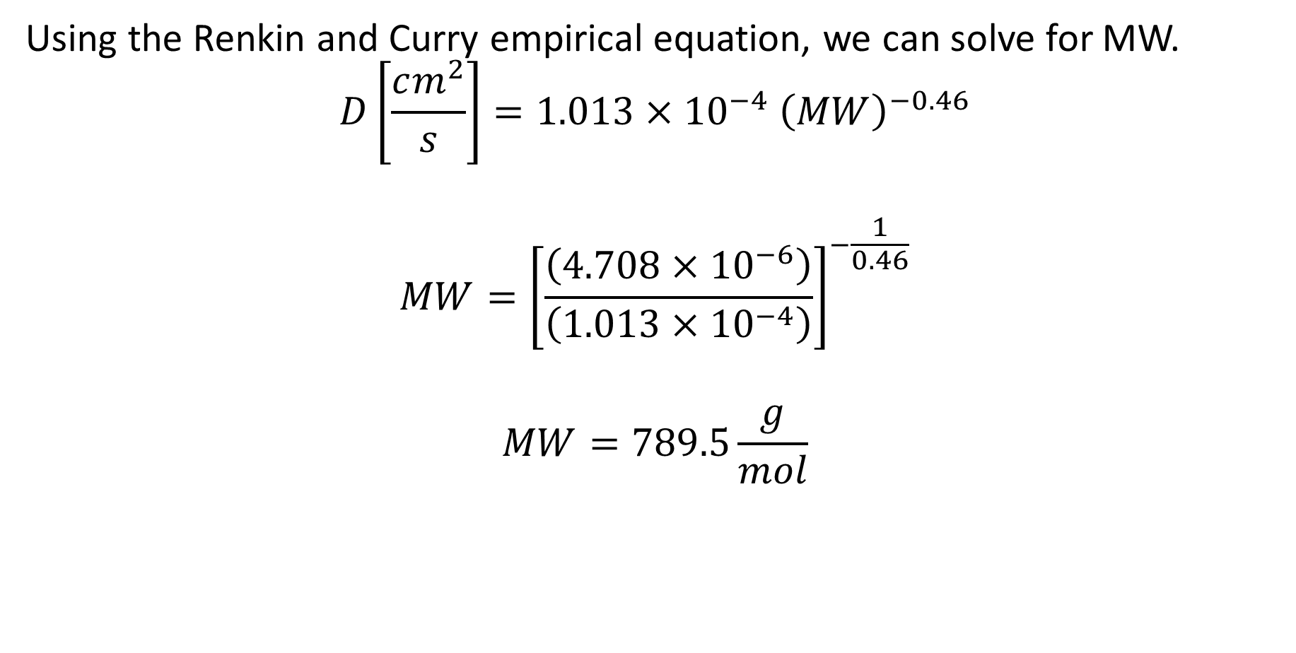
Problem 3 Solution
Using the Renkin and Curry empirical equation, we can solve for MW.
$$D\left[\frac{cm^{2}}{s}\right]=1.013×{10}^{−4} {\left(MW\right)}^{−0.46}$$
$$MW={\left[\frac{\left(4.708×{10}^{−6}\right)}{\left(1.013×{10}^{−4}\right)}\right]}^{−\frac{1}{0.46}}$$
$$MW=789.5\frac{g}{mol}$$

Slide 12
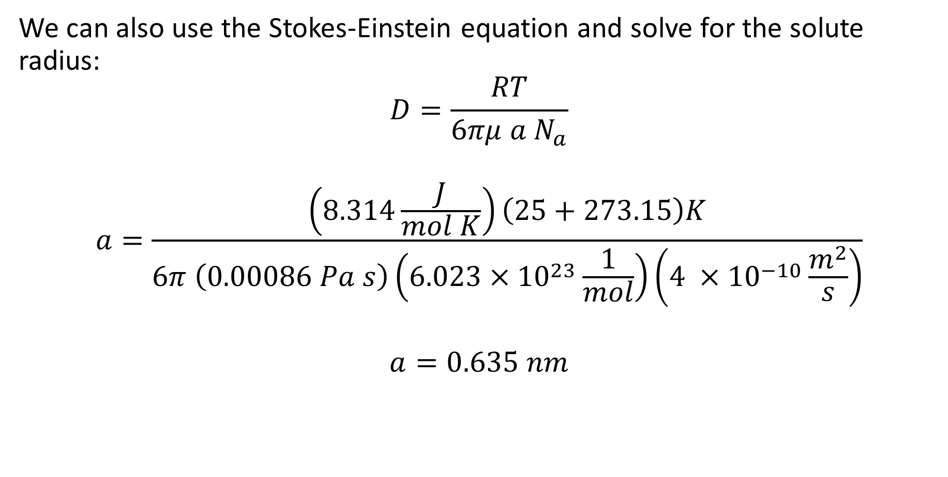
Problem 3 Solution
We can also use the Stokes-Einstein equation and solve for the solute radius:
$$D=\frac{RT}{6πμ a N_{a}}$$
$$a=\frac{\left(8.314\frac{J}{mol K}\right)\left(25+273.15\right)K}{6π \left(0.00086 Pa s\right)\left(6.023×{10}^{23}\frac{1}{mol}\right)\left(4 ×{10}^{−10}\frac{m^{2}}{s}\right)}$$
$$a=0.635 nm$$

Slide 13
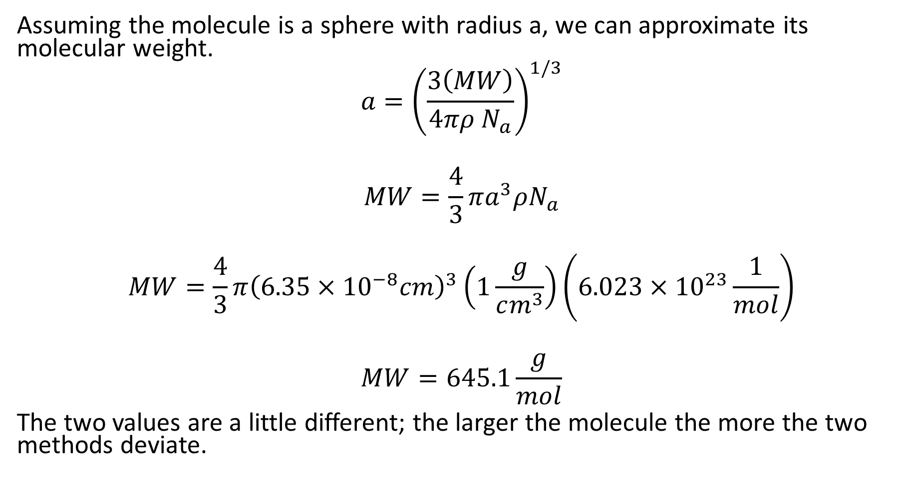
Problem 3 Solution
Assuming the molecule is a sphere with radius a, we can approximate its molecular weight.
$$a={\left(\frac{3\left(MW\right)}{4πρ N_{a}}\right)}^{1/3}$$
$$MW=\frac{4}{3}πa^{3}ρN_{a}$$
$$MW=\frac{4}{3}π{\left(6.35×{10}^{−8}cm\right)}^{3}\left(1\frac{g}{cm^{3}}\right)\left(6.023×{10}^{23}\frac{1}{mol}\right)$$
$$MW=645.1\frac{g}{mol}$$
The two values are a little different; the larger the molecule the more the two methods deviate.

Slide 14
Problem 4
A hollow fiber membrane separator with a nominal molecular weight cutoff of 100 kDa is fed a solution of proteins at a rate of 250 mL/min. The composition of the protein solution is protein A (4 g/L; MW = 20,000), protein B (7 g/L; MW = 150,000), and protein C (6 g/L; MW = 300,000). The filtrate flow rate is found to be 116.2 mL/min and the flow rate of retentate is found to be 133.8 mL/min. The concentration in protein A in the retentate is found to be 5.84 g/L. What is the concentration of A in the filtrate? What are the concentrations of B and C in the retentate?

Slide 15



Problem 4 Solution
It might help to draw a picture to organize your thoughts.
Filtrate
$$Q_{f}=116.2\frac{mL}{min}$$
$$A_{f}=?$$
$$B_{f}=0$$
$$C_{f}=0$$
Separator
In-feed
$$Q_{i}=250\frac{mL}{min}$$
$$A_{i}=4 g/L$$
$$B_{i}=7 g/L$$
$$C_{i}=6 g/L$$
Retentate
$$Q_{r}=133.8\frac{mL}{min}$$
$$A_{r}=5.84 g/L$$
$$B_{r}=?$$
$$C_{r}=?$$

Slide 16
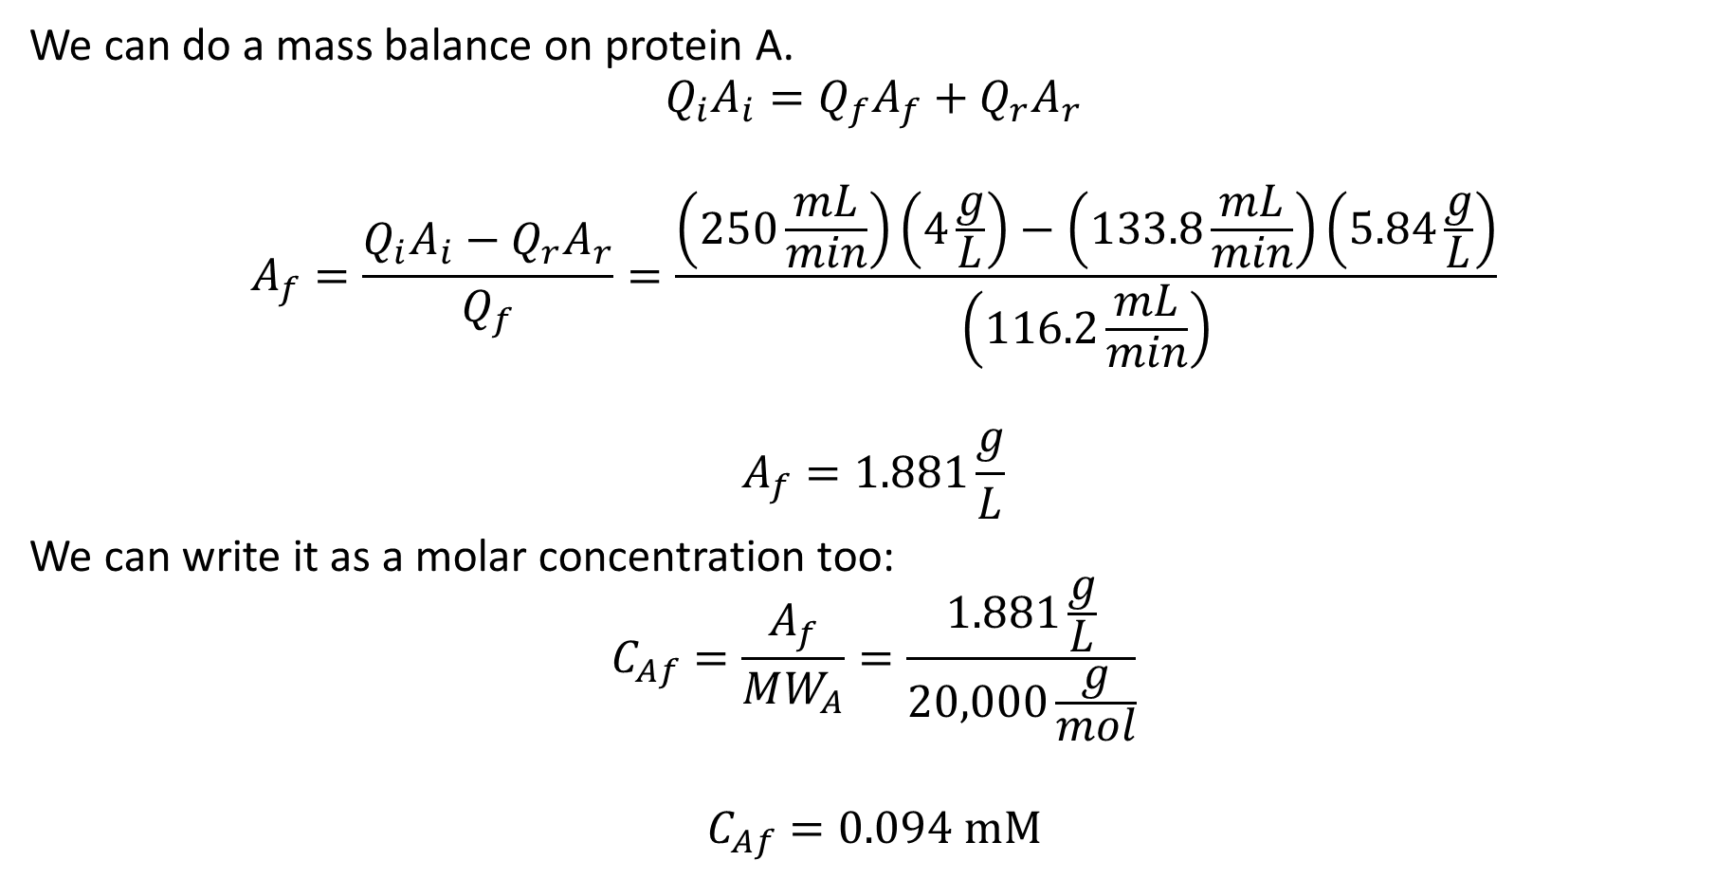
Problem 4 Solution
We can do a mass balance on protein A.
$$Q_{i}A_{i}=Q_{f}A_{f}+Q_{r}A_{r}$$
$$A_{f}=\frac{Q_{i}A_{i}−Q_{r}A_{r}}{Q_{f}}=\frac{\left(250\frac{mL}{min}\right)\left(4\frac{g}{L}\right)−\left(133.8\frac{mL}{min}\right)\left(5.84\frac{g}{L}\right)}{\left(116.2\frac{mL}{min}\right)}$$
$$A_{f}=1.881\frac{g}{L}$$
We can write it as a molar concentration too:
$$C_{Af}=\frac{A_{f}}{MW_{A}}=\frac{1.881\frac{g}{L}}{20,000\frac{g}{mol}}$$
$$C_{Af}=0.094 mM$$

Slide 17
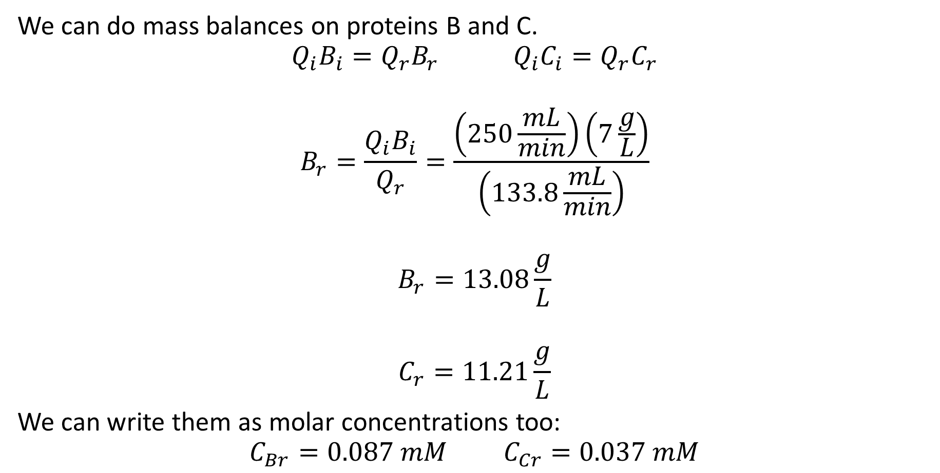
Problem 4 Solution
We can do mass balances on proteins B and C.
$$Q_{i}B_{i}=Q_{r}B_{r} Q_{i}C_{i}=Q_{r}C_{r}$$
$$B_{r}=\frac{Q_{i}B_{i}}{Q_{r}}=\frac{\left(250\frac{mL}{min}\right)\left(7\frac{g}{L}\right)}{\left(133.8\frac{mL}{min}\right)}$$
$$B_{r}=13.08\frac{g}{L}$$
$$C_{r}=11.21\frac{g}{L}$$
We can write them as molar concentrations too:
$$C_{Br}=0.087 mM C_{Cr}=0.037 mM$$

Slide 18

Problem 5
Consider a two-layer model of an artery, as shown below. The layers have thicknesses of $R_{o}−R_{1}$ and $R_{1}−R_{i}$. The inner layer has a diffusion coefficient of $D_{i}$; the outer layer has a diffusion coefficient $D_{o}$. The concentration within the lumen is constant at $C_{i}$. The concentration outside the arterial wall is $C_{o}$.Determine the effective diffusion coefficient.

Slide 19
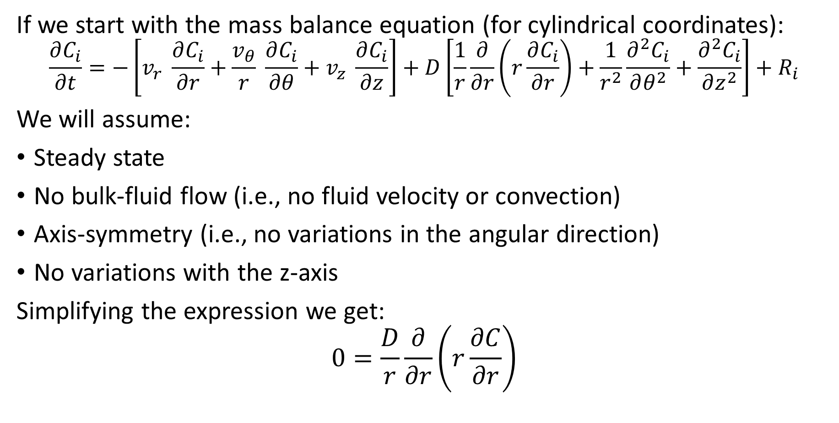
Problem 5 Solution
If we start with the mass balance equation (for cylindrical coordinates):
$$\frac{∂C_{i}}{∂t}=−\left[v_{r} \frac{∂C_{i}}{∂r}+\frac{v_{θ}}{r} \frac{∂C_{i}}{∂θ}+v_{z} \frac{∂C_{i}}{∂z}\right]+D\left[\frac{1}{r}\frac{∂}{∂r}\left(r\frac{∂C_{i}}{∂r}\right)+\frac{1}{r^{2}}\frac{∂^{2}C_{i}}{∂θ^{2}}+\frac{∂^{2}C_{i}}{∂z^{2}}\right]+R_{i}$$
We will assume:
Steady state
No bulk-fluid flow (i.e., no fluid velocity or convection)
Axis-symmetry (i.e., no variations in the angular direction)
No variations with the z-axis
Simplifying the expression we get:
$$0=\frac{D}{r}\frac{∂}{∂r}\left(r\frac{∂C}{∂r}\right)$$

Slide 20
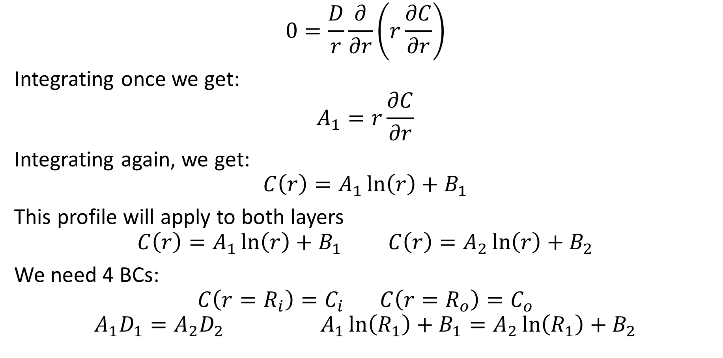
Problem 5 Solution
$$0=\frac{D}{r}\frac{∂}{∂r}\left(r\frac{∂C}{∂r}\right)$$
Integrating once we get:
$$A_{1}=r\frac{∂C}{∂r}$$
Integrating again, we get:
$$C\left(r\right)=A_{1}\ln\left(r\right)+B_{1}$$
This profile will apply to both layers
$$C\left(r\right)=A_{1}\ln\left(r\right)+B_{1} C\left(r\right)=A_{2}\ln\left(r\right)+B_{2}$$
We need 4 BCs:
$$C\left(r=R_{i}\right)=C_{i} C\left(r=R_{o}\right)=C_{o}$$
$$A_{1}D_{1}=A_{2}D_{2} A_{1}\ln\left(R_{1}\right)+B_{1}=A_{2}\ln\left(R_{1}\right)+B_{2}$$

Slide 21
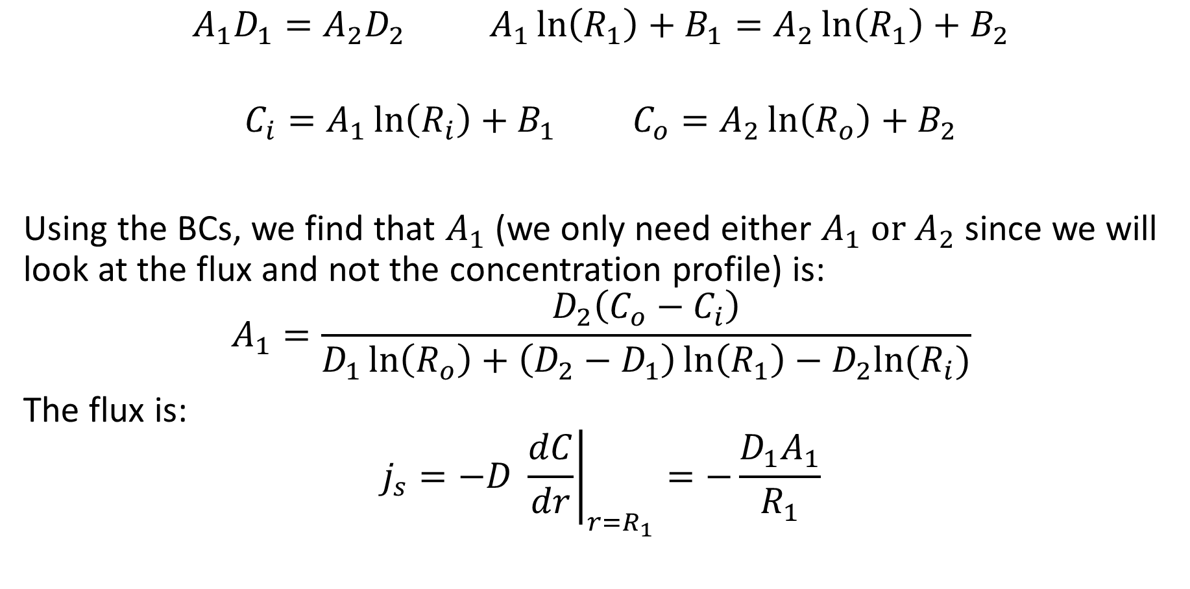
Problem 5 Solution
$$A_{1}D_{1}=A_{2}D_{2} A_{1}\ln\left(R_{1}\right)+B_{1}=A_{2}\ln\left(R_{1}\right)+B_{2}$$
$$C_{i}=A_{1}\ln\left(R_{i}\right)+B_{1} C_{o}=A_{2}\ln\left(R_{o}\right)+B_{2}$$
Using the BCs, we find that $A_{1}$ (we only need either $A_{1} \text{or} A_{2}$ since we will look at the flux and not the concentration profile) is:
$$A_{1}=\frac{D_{2}\left(C_{o}−C_{i}\right)}{D_{1}\ln\left(R_{o}\right)+\left(D_{2}−D_{1}\right)\ln\left(R_{1}\right)−D_{2}ln⁡(R_{i})}$$
The flux is:
$$j_{s}=−D {\left.\frac{dC}{dr}\right|}_{r=R_{1}}=−\frac{D_{1}A_{1}}{R_{1}}$$

Slide 22
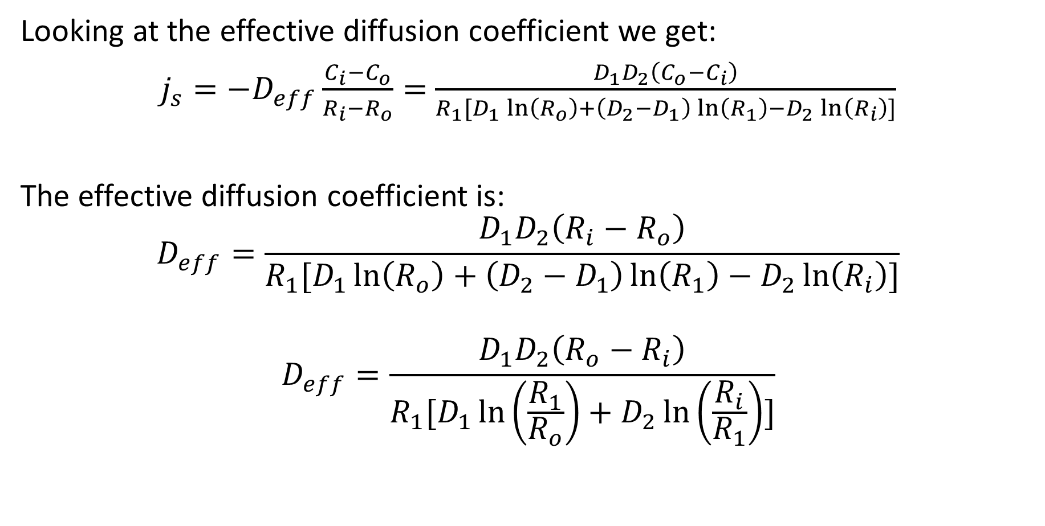
Problem 5 Solution
Looking at the effective diffusion coefficient we get:
$j_{s}=−D_{eff}\frac{C_{i}−C_{o}}{R_{i}−R_{o}}=$ $\frac{D_{1}D_{2}\left(C_{o}−C_{i}\right)}{R_{1}[D_{1}\ln\left(R_{o}\right)+\left(D_{2}−D_{1}\right)\ln\left(R_{1}\right)−D_{2}\ln\left(R_{i}\right)]}$
The effective diffusion coefficient is:
$$D_{eff}=\frac{D_{1}D_{2}\left(R_{i}−R_{o}\right)}{R_{1}[D_{1}\ln\left(R_{o}\right)+\left(D_{2}−D_{1}\right)\ln\left(R_{1}\right)−D_{2}\ln\left(R_{i}\right)]}$$
$$D_{eff}=\frac{D_{1}D_{2}\left(R_{o}−R_{i}\right)}{R_{1}[D_{1}\ln\left(\frac{R_{1}}{R_{o}}\right)+D_{2}\ln\left(\frac{R_{i}}{R_{1}}\right)]}$$

Slide 23

Problem 5 Solution (alternative)
Let’s look at just one portion of the wall.
$$C\left(r\right)=A_{1}\ln\left(r\right)+B_{1}$$
We have 2 BCs
$$C\left(r=R_{i}\right)=C_{i} C\left(r=R_{1}\right)=C_{1}$$
Solving for $A_{1}$, we get:
$$C_{i}−C_{1}=A_{1}\ln\left(\frac{R_{i}}{R_{1}}\right)$$
$$A_{1}=\frac{C_{i}−C_{1}}{\ln\left(\frac{R_{i}}{R_{1}}\right)}$$
The equation for $A_{2}$ would look similar:
$$A_{2}=\frac{C_{1}−C_{o}}{\ln\left(\frac{R_{1}}{R_{o}}\right)}$$

Slide 24
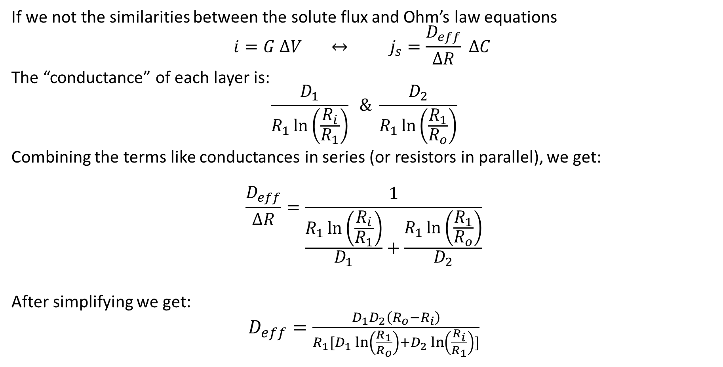
Problem 5 Solution (alternative)
If we not the similarities between the solute flux and Ohm’s law equations
$$i=G ∆V ↔ j_{s}=\frac{D_{eff}}{∆R} ∆C$$
The “conductance” of each layer is:
$$\frac{D_{1}}{R_{1}\ln\left(\frac{R_{i}}{R_{1}}\right)} \& \frac{D_{2}}{R_{1}\ln\left(\frac{R_{1}}{R_{o}}\right)}$$
Combining the terms like conductances in series (or resistors in parallel), we get:
$$\frac{D_{eff}}{∆R}=\frac{1}{\frac{R_{1}\ln\left(\frac{R_{i}}{R_{1}}\right)}{D_{1}}+\frac{R_{1}\ln\left(\frac{R_{1}}{R_{o}}\right)}{D_{2}}}$$
After simplifying we get:
$D_{eff}=\frac{D_{1}D_{2}\left(R_{o}−R_{i}\right)}{R_{1}[D_{1}\ln\left(\frac{R_{1}}{R_{o}}\right)+D_{2}\ln\left(\frac{R_{i}}{R_{1}}\right)]}$

